Slide 1
Project - TrAn-SiSS
Traffic Analyzers and Signal System Simulator

Slide 2
INTRODUCTION
Traffic Analyzers and Signal System Simulator(TrAn-SiSS) features a unique analytical Network Model, it is capable of incorporating different types of intersection and simulating diverse Traffic Movement. TrAn-SiSS allows to design and simulate vehicle traffic for a map designed by the user. It facilitates the user to design a road map network consisting of streets and junctions. Once a road map network is ready, during the simulation the street disciplines and all movement data can be specified, and all lane flow calculations, capacity, performance estimation and signal timing calculations are carried out by various algorithms formulated by the developing team.

Slide 3
TEAM DETAILS
MEMBER NAME | EMAIL ID
Niladri Dutta (SPOC) | nd933@snu.edu.in
Nilesh Gupta | ng945@snu.edu.in
Pranshu Srivastava | ps372@snu.edu.in
Vyom Saxena | vs590@snu.edu.in

Slide 4
DESCRIPTION
TrAn-SiSS allows to design and simulate vehicle traffic for a given map design(the user can design a road network in the form of a graph). The intersection/junctions of the roads will act as the nodes of the graph network. The roads between each junction(node) of the graph will be the edges of the graph. Each road will be implemented as a queue data structure with a specified length(capacity of vehicles). At each node there will be a traffic signal with a traffic light corresponding to each road directed to that junction(node). The traffic light will operate using an analyser which will determine the switching of the traffic signal light.

Slide 5
User and Use Cases
The user in this software:-
Administrator : User who can add/modify/delete map designs and also add/delete users. Also the administrator can change the access criteria of each user.
Standard Users : These users can simulate the vehicle movement in the map and view the different pattern of vehicle traffic created on the map.

Slide 6
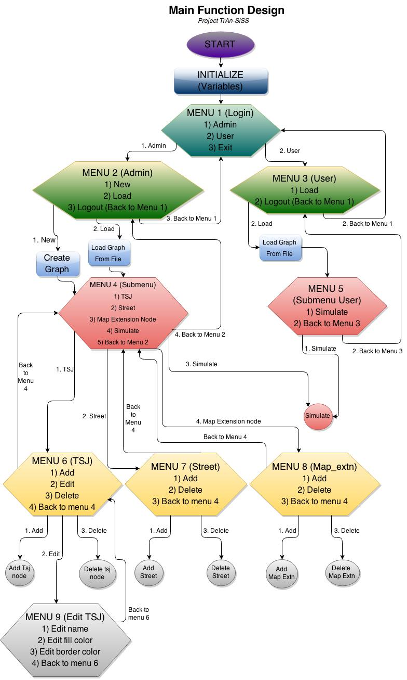
MAIN
FUNCTION
DESIGN

Slide 7
DESIGN DESCRIPTION
The above flow chart depicts the main function design of the project. When the software starts, at first the variables are initialized and a menu is displayed asking to choose among admin and user.
Admin menu asks the admin to login with his credentials and on successful login, takes him to another menu asking him to choose whether to Create a new graph or load graph from an existing file. Both the options take the admin to a submenu asking him to choose among traffic signal junction, street, map extension node or simulate the program.

Slide 8
Traffic signal junction menu allows the admin to add, edit or delete a traffic signal junction.Edit traffic signal junction further allows the admin to edit name, fill color or border color of a junction.Street menu allows the admin to add or delete a street while map extension node menu allows him to add or delete a node.
Now inside user menu, the user is asked to login with his credentials and on successful login, he is allowed to load graph from a file and simulate the program.

Slide 9
CODE SKELETON
Data Types
1) Traffic Signal Junction (traffic_sig_jn)
Description:-
Nodes which together form a graph data structure and contain the traffic signal controls at the lane junctions.
2) Lane (lane)
Description:-
Queue of vehicle (struct vehicle data type) which would contain all the vehicles queues in a lane.

Slide 10
3) Street (street)
Description:-
Contains the lanes between two Traffic Signal Junction Nodes.
4) Traffic Signal Light (traffic_light)
Description:-
Traffic signal lights (Red, Yellow & Green ) control.
5) Vehicle(vehicle)
Description:-
Contains data variables describing the vehicle object.
6) Route (route)
Description:-
Queue of steps for taking the route from the starting to the end map extension node.

Slide 11
7) Map Extension Node(map_extn)
Description:-
Nodes that are an extension to the map boundaries. This object will be static in the program.
8) Map Extension (map_extn_list)
Description:-
Structure to represent each node which is used to extend the graph of TSJs.
9) Vertex Node (vertex_node)
Description:-
Structure to represent each node(source node) of the Adjacency List.

Slide 12
10) Adjacent List (adj_list)
Description:-
Structure to represent each linked list of the Adjacency List. The structure itself is a linked list.
11) Graph (graph)
Description:-
Structure to represent each node of the Adjacency List.

